Slide 1
COAL LAB EL229 – Section H
Group Members:
-Hermain Qadir - 19K-1517
-Anusha Saad – 19K-0281

Slide 2

ENTER & LEAVE INSTRUCTION
This is how a function definition looks like:
Factorial PROC
push ebp
mov ebp,esp
.
.
.
pop ebp

Slide 3
Code with enter and leave commands
Factorial PROC
Enter 0,0
.
.
.
LEAVE

Slide 4
The semantics of ENTER and LEAVE
ENTER digit, digit
This is how a common ENTER instruction looks like. Enter is a two-operand instruction. The first digit signifies the bytes stored in stack for local variables, whereas the second digit represents the nesting level.
LEAVE is a no-operand instruction.

Slide 5
Advanced Procedure → It calculates square of a variable that is created locally. The value is taken in from the user.
MAIN PROCEDURE
LocalSquare PROCEDURE
.data
msginput BYTE "Enter the integer: ", 0
msgoutput BYTE "Square is: “, 0
LocalSquare PROTO
.code
main PROC
enter 0,0
INVOKE LocalSquare
LEAVE
ret
exit
main ENDP
LocalSquare PROC
enter 4,1
mov edx, OFFSET msginput
call WriteString
call crlf
call ReadDec
mov [ebp-4], eax
mul eax
mov edx, OFFSET msgoutput
Call WriteString
Call WriteDec
LEAVE
ret
LocalSquare ENDP
END main
One local variable and
1 nesting level
No local variables and zero nesting level

Slide 6
Code, otherwise and stack representation
ret add to main
ebp
Local variable [esp-4]
LocalSquare PROC
Push ebp
mov ebp, esp
sub esp, 4
.
.
pop ebp

Slide 7
ADDR Instruction Used for passing offset/address of an array
The ADDR operator, also available in 32-bit mode, can be used to pass a pointer argument when calling a procedure using INVOKE. Used only in conjunction with INVOKE and not with other instructions.
ADDR is used only with global variables. Global variables are the one that are intialised in the data segment. Not with local variables.

Slide 8
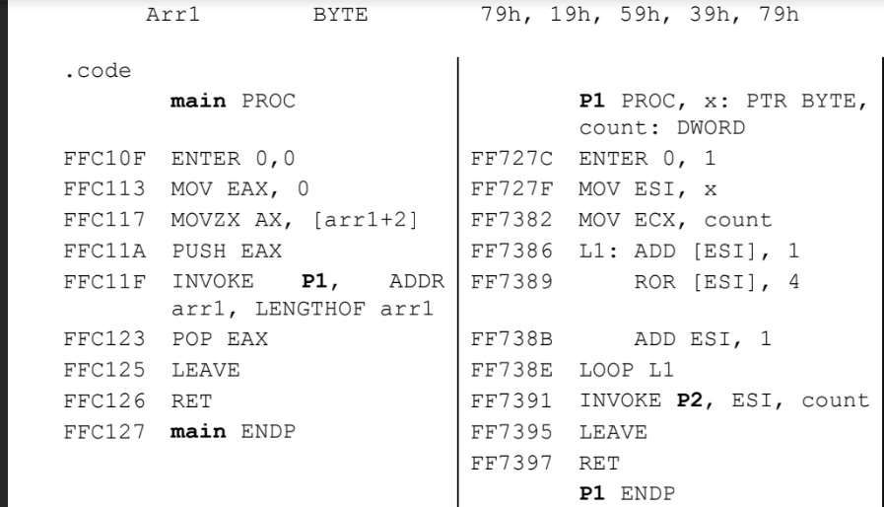
Example Code of ADDR →

Slide 9
Instead of ADDR →
.data
Arr BYTE 10h, 20h, 30h, 40h, 50h
.code
main PROC
mov esi, OFFSET Arr
INVOKE P1, esi
P1 PROC, y: PTR BYTE

Slide 10
INVOKE Directive
The INVOKE directive, only available in 32-bit mode, pushes arguments on the stack (in the order specified by the MODEL directive’s language specifier) and calls a procedure.
INVOKE is a convenient replacement for the CALL instruction because it lets you pass multiple arguments using a single line of code.

Slide 11
INVOKE vs CALL
.code
INVOKE Factorial //
Call Factorial
INVOKE and CALL work the same way as long as the procedure has no arguments being passed.
If the procedure has arguments then CALL is not a suitable choice.
.data
array1 DWORD 10, 20, 30, 40
.code
main PROC
INVOKE P1, LENGTHOF array1, TYPE array1
.
.
.
(Call P1 will not work in the case above)

Slide 12
Code using INVOKE →
.code
main PROC
enter 0,0
mov eax, 0
mov ecx, 0
mov edx, OFFSET entry1
call WriteString
call readDec
mov intx, eax
mov ecx, eax
call crlf
mov edx, OFFSET entry2
call WriteString
call readDec
mov inty, eax
call crlf
INVOKE GCD, intx, inty
inty
intx
ret address to main

